Slide 1
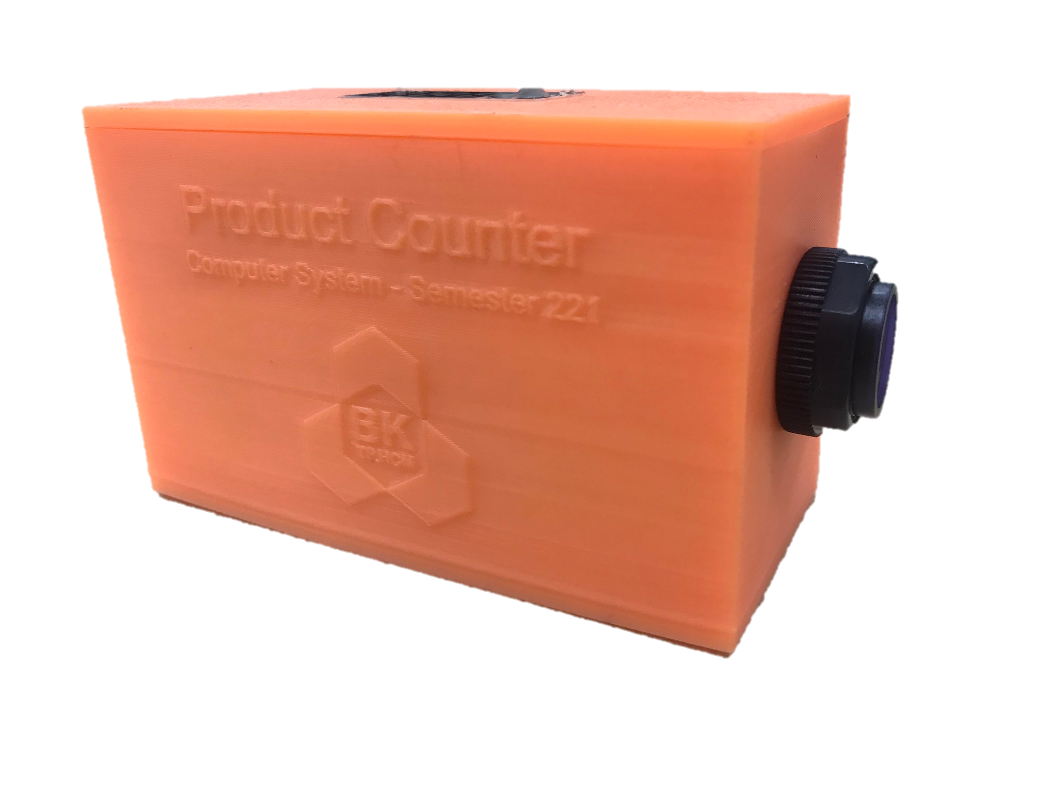
COMPUTER SYSTEMS ENGINEERING Group 10 DESIGN A PRODUCT COUNTER USING 8086/ARM PROCESSOR 12th December, 2022

Slide 2
GROUP MEMBERS
1. DINH HOANG LUAN
2. BUI THANH TUNG
3. LUONG TRIEN THANG
4. PHAN QUANG MINH
2051145
2051213
2051194
2051052
2

Slide 3
TABLE OF CONTENTS
01
INTRODUCTION
03
HARDWARE
02
ALGORITHM
04
RESULT
Product Counter, and its applications
Pi Pico (ARM Cortex M0+)
Proximity Sensor
7-Segment display...
About the algorithm, the flow chart and code to make it run successfully
The completed product counter and how to operate it
3

Slide 4
INTRODUCTION
In the current technological era, with the very strong development of science and technology, product counting models were born based on chip manufacturing technology.
Counters are used to keep track of the number of products produced in a production line or even in a factory.
In this project, our team will describe the objectives of product counter by using an ARM processor.
4

Slide 5

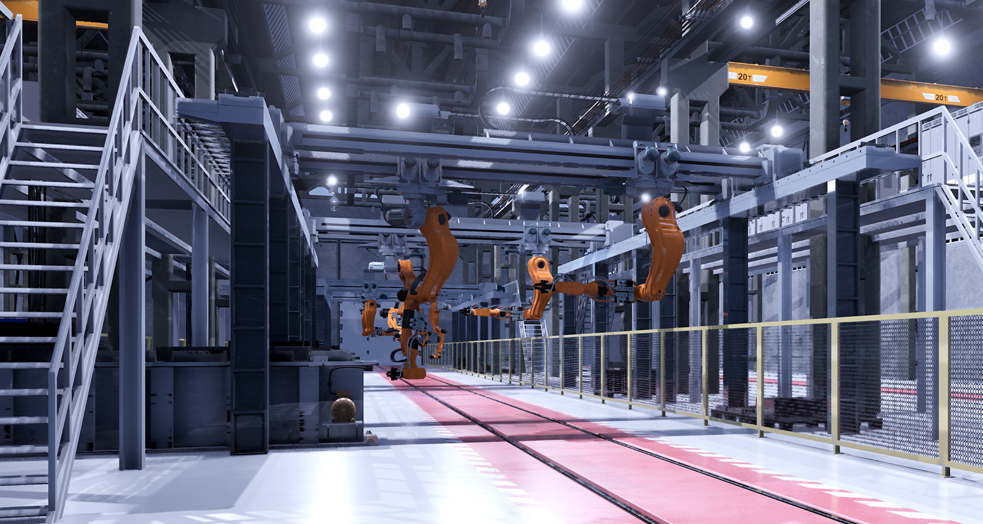
APPLICATIONS
PHARMATICAL PRODUCTS
MANUFACTURING
5

Slide 6

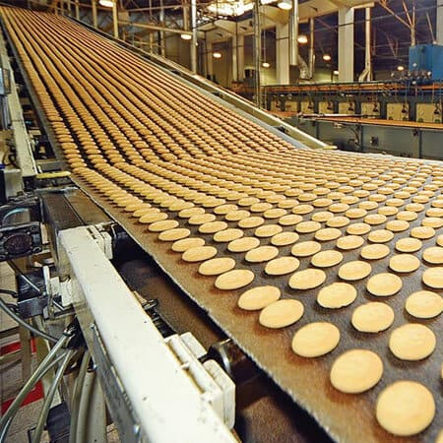
APPLICATIONS
FACTORY APPLICATION
FOOD & BEVERAGE
6

Slide 7
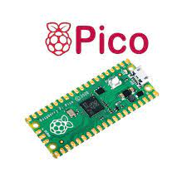
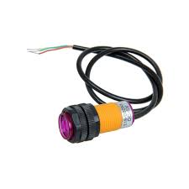
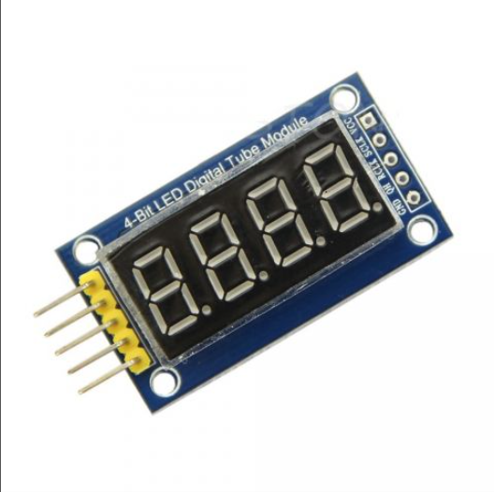
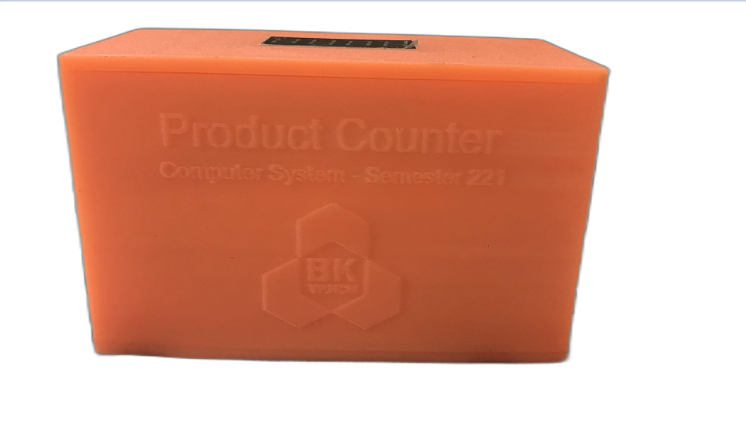
HARDWARE
RASBERRY PI PICO
PROXIMITY SENSOR
4-DIGIT -7 SEGMENT DISPLAY
Microcontroller Unit
For detecting objects
3D PRINTED
CASE
Protect the device
For displaying product
count
7

Slide 8
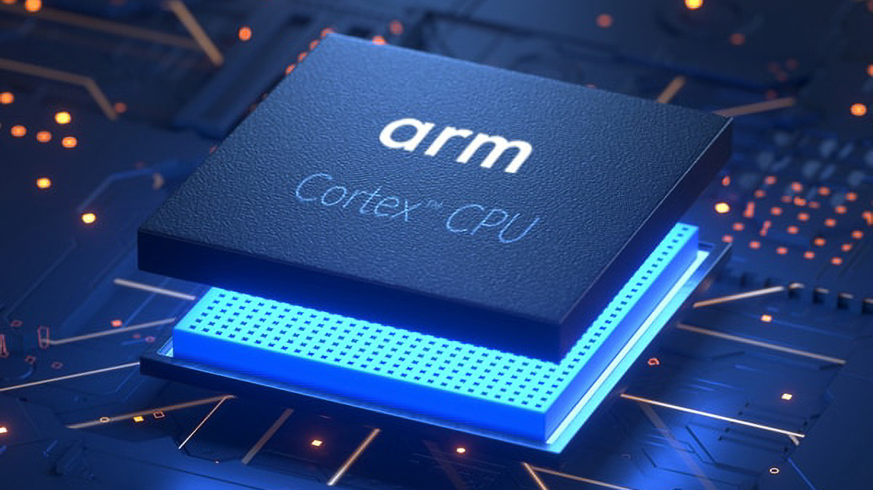
ARM PROCESSOR
ARM processor is one of a family of central processing units based on the reduced instruction set computer architecture for computer processors.
ARM processor is best for performance per watt, so it is widely used in mobile devices.
Our team decided to choose ARM Cortex M0+ Processor to implement the project, specifically Raspberry Pi Pico microcontroller.
8

Slide 9
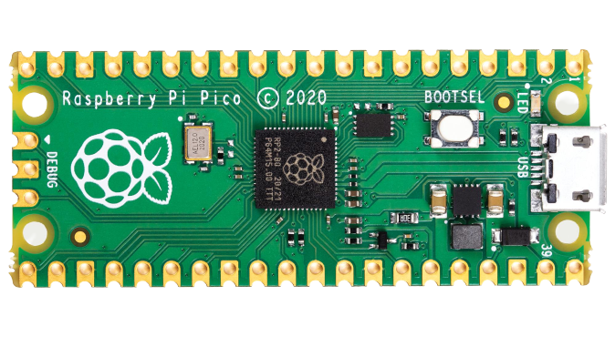
DEFINE THE PINS
Raspberry Pi Pico has 26 GPIO pins, and our team just only use 5 of these:
• GPIO[18], GPIO[19], GPIO[20] for DIO, RCLK, SCLK respectively of four-digit 7-segment display.
• GPIO[16] for the signal pin of proximity sensor.
• GPIO[17] for the output data to buzzer.
9

Slide 10
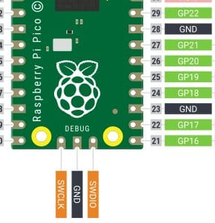
DEFINE THE PINS
SCLK
RCLK
DIO
BUZZER
IR
10

Slide 11
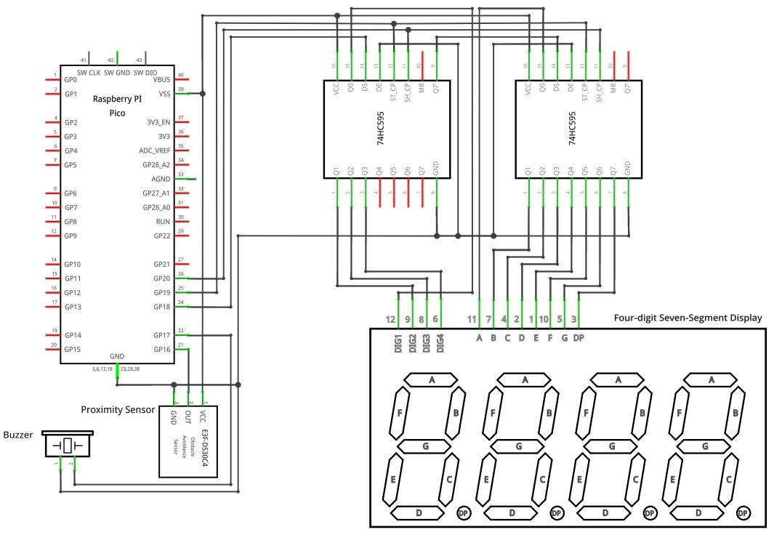
WIRING SCHEMATIC
11

Slide 12
ALGORITHM
There are 2 methods that our team creates: Using Interrupt Vector or Program Loop.
In this project our team prefers to use a Program Loop. The MCU will be constantly in a loop for reading IR, checking the IR state.
12

Slide 13
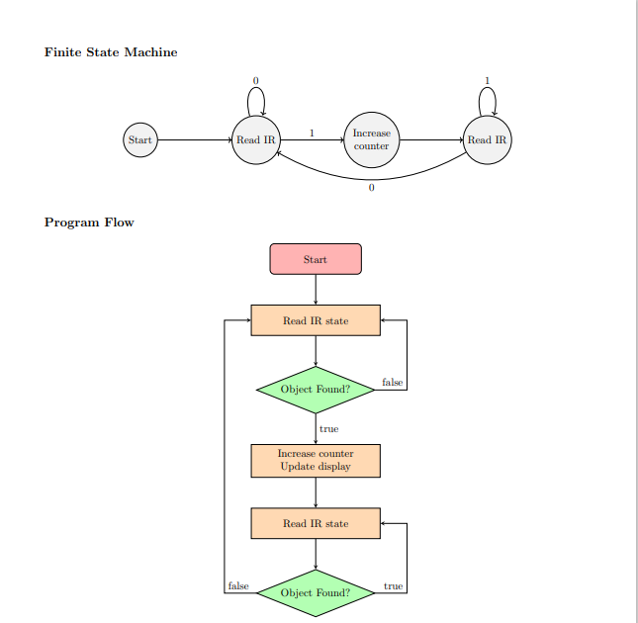
FINITE STATE MACHINE
13

Slide 14
FLOWCHART
14

Slide 15


SOFTWARE
C LANGUAGE
KEIL-C
15

Slide 16
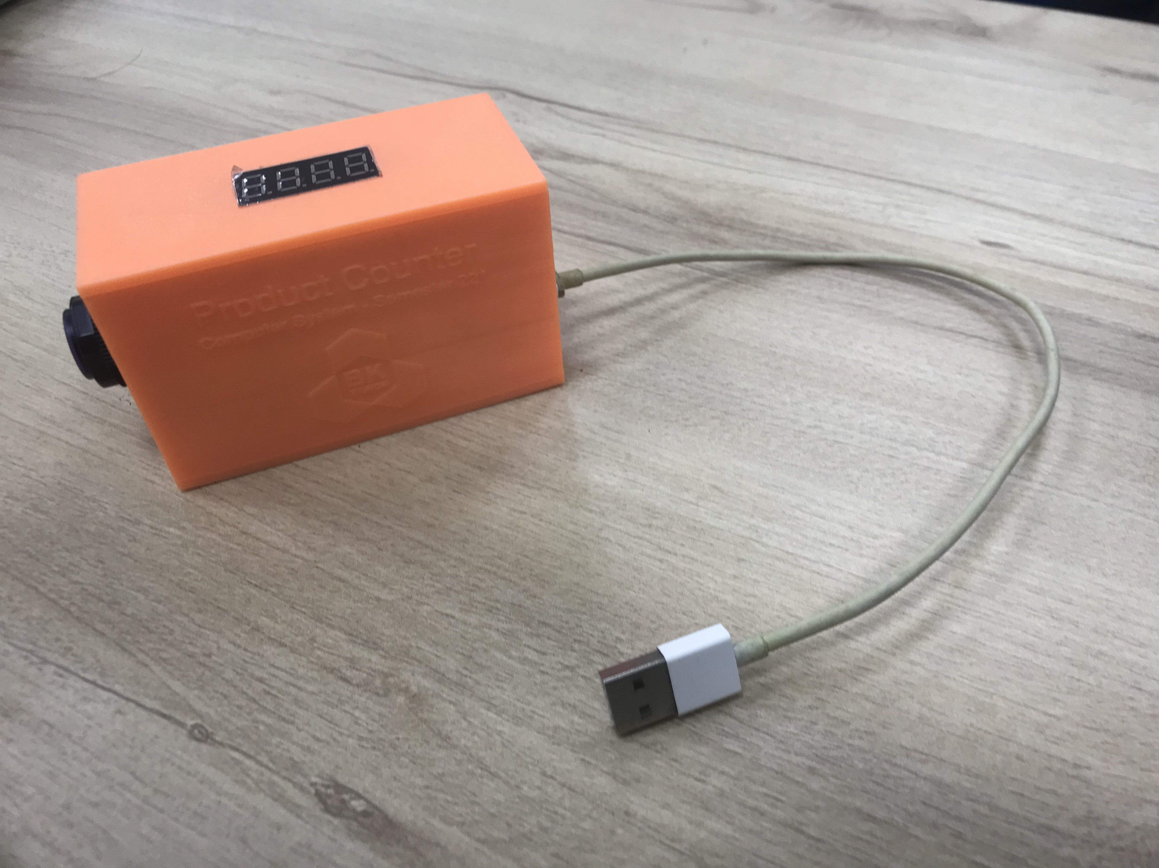

RESULT OF THE PROJECT
16

Slide 17
REFERENCES
[1] CMOS Shift Register TM74HC59. Titan Micro Electronics.
[2] Digilent. Learn.Digilentinc — Music with a Piezoelectric Buzzer. url: https://learn.digilentinc.
com/Documents/392.
[3] Electronics Hub. IR (Infrared) Obstacle Detection Sensor Circuit. 2015. url: https://www.
electronicshub.org/ir-sensor/.
[4] Nikhil Joshi. What are multiplexed displays and use of multiplexing - Arduino - C Programming,Seven Segment - Dotnetlovers. 2020. url: https://www.dotnetlovers.com/article/
10246/what-are-multiplexed-displays-and-use-of-multiplexing.
[5] Raspberry Pi Ltd. Pico-R3-A4-Pinout. 2022. url: https://datasheets.raspberrypi.com/
pico/Pico-R3-A4-Pinout.pdf.
[6] Raspberry Pi Pico C/C++ SDK. 1.4.0. Raspberry Pi Ltd. 06/2022.
[7] Raspberry Pi Pico Datasheet. 1.9. Raspberry Pi Ltd. 06/2022.
[8] Gabriel Wang. Pico Template. 2022. url: https : / / github . com / GorgonMeducer / Pico _
Template.
[9] Waveshare. Raspberry Pi Pico - Waveshare Wiki. 2022. url: https://www.waveshare.com/
wiki/Raspberry_Pi_Pico.
[10] Wikipedia. ARM architecture family - Wikipedia. 2022. url: http://en.wikipedia.org/
wiki/ARM_architecture_family.
[11] Wikipedia. Buzzer - Wikipedia. 2022. url: https://en.wikipedia.org/wiki/Buzzer.
[12] Wikipedia. Microcontroller - Wikipedia. 2022. url: http : / / en . wikipedia . org / wiki /
Microcontroller.
[13] Wikipedia. Multiplexed display - Wikipedia. 2022. url: https://en.wikipedia.org/wiki/
Multiplexed_display.
[14] Wikipedia. Seven-segment display - Wikipedia. 2022. url: https://en.wikipedia.org/wiki/
Seven-segment_display.
17

Slide 18

THANKS FOR LISTENING

